Slide 1


Examination of Brain MRI Slices to Detect Alzheimer's Disease
DSA0216-Computer Vision with OpenCV for Modern AI
Presented By
A.Harsha Mukundha(192324070)
S.Ayyappa(192324166)
G.Goutham(192324265)
Guided By
T Dr. Senthilvadivu S
Dr. Kumaragurubaran

Slide 2
INTRODUCTION
Alzheimer’s Disease (AD) is a severe disorder that gradually destroys memory and cognitive abilities.
Alzheimer's disease is a significant contributor to abnormal mental health in older adults.
Early diagnosis is crucial because it allows timely medical intervention, patient care planning, and improvement of quality of life.
Recognizing and addressing Alzheimer's disease (AD) in elderly patients promptly is crucial for preserving their health status.

Slide 3
OBJECTIVE
Analyze brain MRI slices for identifying structural differences between healthy (control) subjects and patients affected by Alzheimer’s Disease.
To preprocess MRI images (noise removal, normalization, resizing, and slice selection) to improve image quality for accurate analysis.
To extract relevant features from MRI slices that represent brain atrophy and tissue changes associated with Alzheimer’s Disease.
To classify brain MRI images into control (normal) and Alzheimer’s Disease categories using image analysis / machine learning techniques.

Slide 4
PROBLEM STATEMENT
Manual analysis of MRI slices is challenging because it is time-consuming, and depends heavily on the expertise of radiologists.
In the early stages of Alzheimer’s Disease, brain changes are very subtle, making it difficult to clearly distinguish affected patients from healthy control subjects.
Here is a need for an automated system that can examine brain MRI slices and accurately classify them as normal (control) or Alzheimer’s Disease.

Slide 5
Literature Review
Year | Title | Objective | Advantages | Disadvantages
2020 | MADGAN: Unsupervised Medical Anomaly Detection GAN Using Multiple Adjacent Brain MRI Slice Reconstruction | Detect MRI anomalies using GAN-based slice reconstruction. | • Works without labeled data (unsupervised) • Detects subtle MRI abnormalities | • Low accuracy for early AD/MCI • Limited dataset reduces robustness
2021 | Deep Sequence Modelling for Alzheimer’s Disease Detection Using MRI | Classify Alzheimer’s by learning MRI slice sequences. | • Combines CNN + sequence modeling • Captures spatial relationships across slices | • High computational cost . Moderate accuracy compared to newer models •.Sensitive to MRI preprocessing
2022 | Alzheimer’s Disease Diagnosis With Multiview-Slice Attention and 3D CNN | Improve AD diagnosis using multi-view attention and 3D CNN features. | • Combines 2D slice info + 3D volume features • Attention mechanism highlights key brain regions | • Very complex architecture Requires strong GPU resources Time-consuming preprocessing
2023 | A Deep Learning Framework for Early Diagnosis of Alzheimer’s Disease on MRI Images | Automatically detect early Alzheimer’s from MRI images. | • Effective for early AD detection • Uses augmentation to avoid overfitting | • Limited generalization to multi-site datasets • Still prone to overfitting on small datasets
2024 | Hybrid Explainable AI Model for Early Alzheimer’s Diagnosis Using Structural MRI | Provide accurate and explainable early Alzheimer’s prediction using MRI. | • Provides visual explanations (XAI) • Hybrid deep + ML model increases accuracy • More clinician-friendly | • Explainability maps not always clear • Slightly lower accuracy vs pure deep learning models

Slide 6
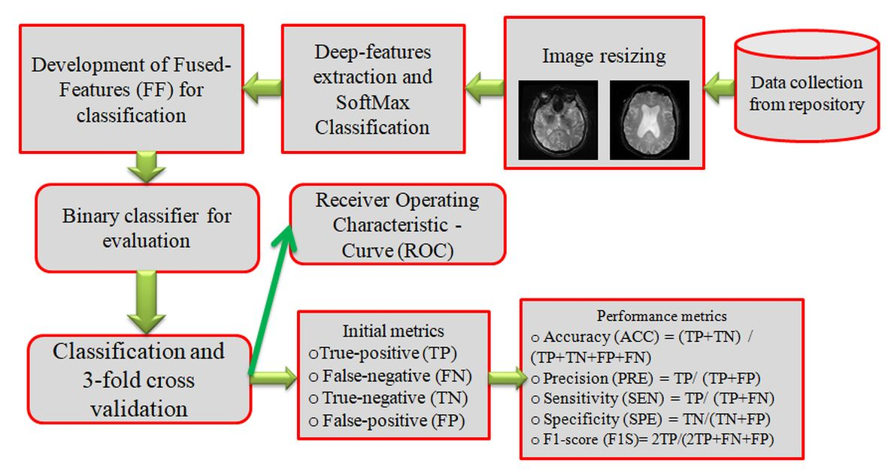
METHODOLOGY
Fig. 1. classify MRI into healthy/AD class

Slide 7
Module-1: MRI Slice Preprocessing & Feature Extraction
Data Collection
MRI brain images are gathered from available medical imaging repository.
Dataset includes both Alzheimer’s and healthy control samples.
Image Preprocessing
All brain MRI slices are standardized to a fixed resolution.
Preprocessing helps reduce noise and variations across subjects.
Deep-Feature Extraction
A DL Model is used to automatically extract hierarchical features.
A SoftMax classifier produces initial class probabilities.

Slide 8
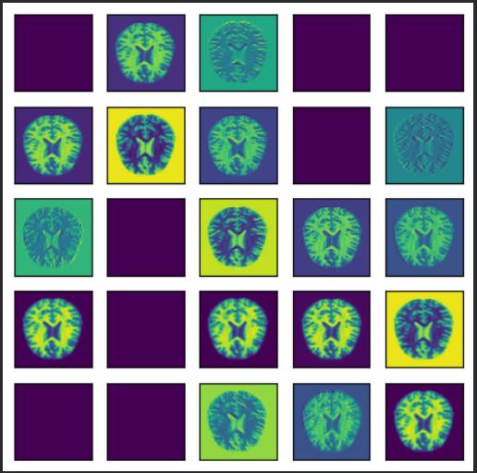
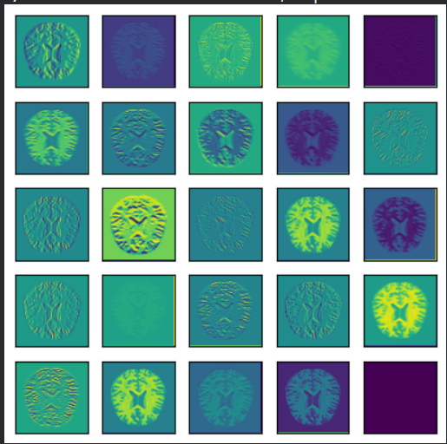
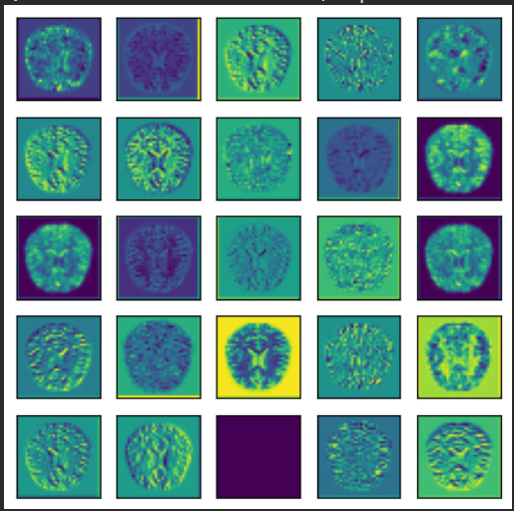
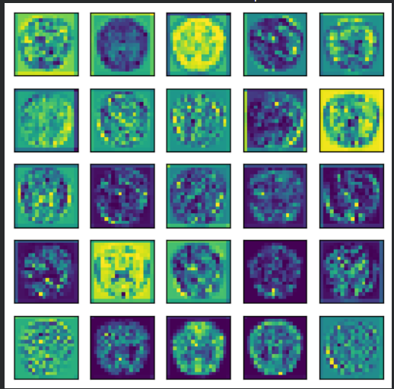
Development of Fused Features (FF)
Deep features from different network layers or models are combined/fused.
Helps improve classification performance compared to using a single feature source.
(a)CL1
(b)CL2
(c)CL3
(d)CL4
Fig.2. Result of different CL for MN1

Slide 9
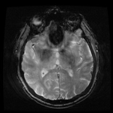
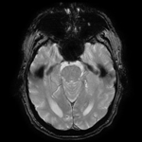
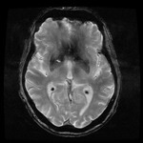
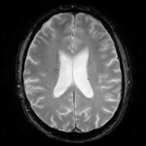
OUTPUT
Class | Brain MRI-slices
 | Total | Train | Validate | Test
CD | 1000 | 800 | 100 | 100
AD | 1000 | 800 | 100 | 100
Healthy
AD
Fig. 3. Sample images from the MRI-database

Slide 10
Module-2: Alzheimer’s Disease Detection and Classification
Binary Classification Framework
A binary classifier is trained using Fused Features.
Model predicts whether an MRI belongs to Alzheimer’s or Control class.
3-Fold Cross-Validation
The dataset is divided into three equal subsets.
Training and testing occur in three rounds, each time using a different subset for testing.
Improves reliability and reduces overfitting risks.

Slide 11
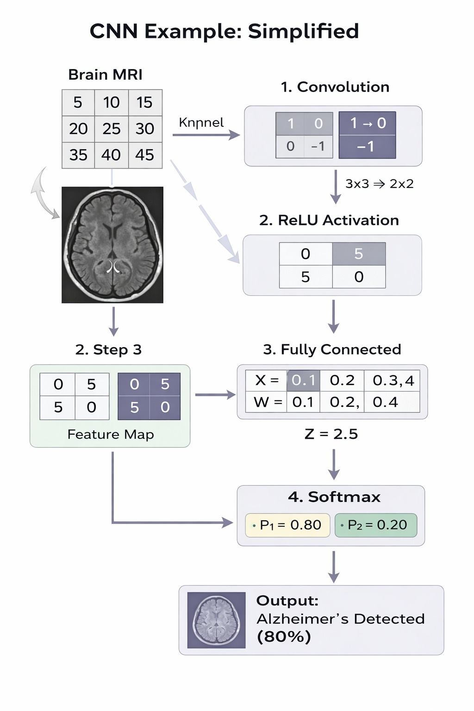
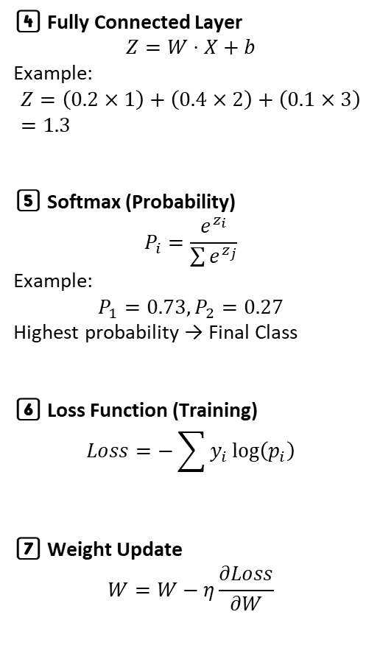
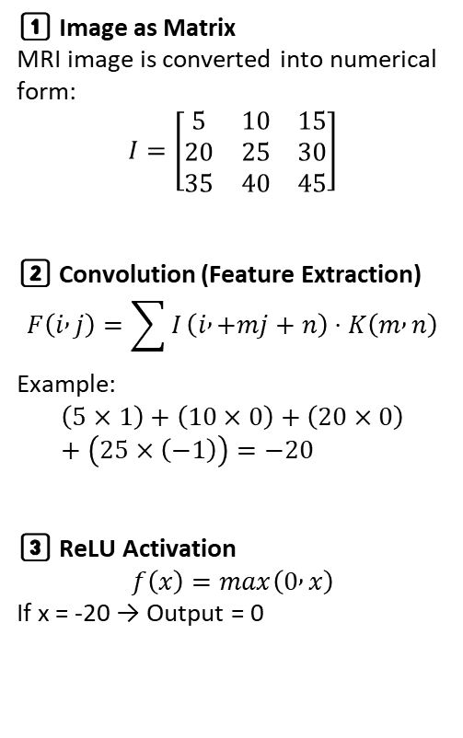
“MATHEMATICAL FRAMEWORK OF CNN”
1️⃣ Image as Matrix
MRI image is converted into numerical form:
$$I=\left[\begin{matrix}5 & 10 & 15 \\ 20 & 25 & 30 \\ 35 & 40 & 45\end{matrix}\right]$$
2️⃣ Convolution (Feature Extraction)
$$F\left(i , j\right)=\sum{I}\left(i , +mj+n\right)⋅K\left(m , n\right)$$
Example:
$$\left(5×1\right)+\left(10×0\right)+\left(20×0\right)+\left(25×\left(−1\right)\right)=−20$$
3️⃣ ReLU Activation
$$f\left(x\right)=max\left(0 , x\right)$$
If x = -20 → Output = 0
4️⃣ Fully Connected Layer
$$Z=W⋅X+b$$
Example:
$$Z=\left(0.2×1\right)+\left(0.4×2\right)+\left(0.1×3\right)=1.3$$
5️⃣ Softmax (Probability)
$$P_{i}=\frac{e^{z_{i}}}{\sum{e^{z_{j}}}}$$
Example:
$$P_{1}=0.73, P_{2}=0.27$$
Highest probability → Final Class
6️⃣ Loss Function (Training)
$$Loss=−\sum{y_{i}}log⁡\left(p_{i}\right)$$
7️⃣ Weight Update
$$W=W−η\frac{∂Loss}{∂W}$$

Slide 12
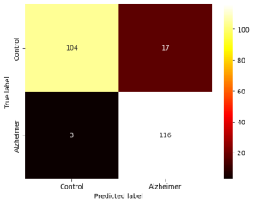
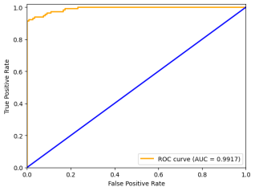
OUTPUT
Performance Evaluation
ROC curve and metrics (Accuracy, Precision, Sensitivity, Specificity, F1-score) assess the model’s diagnostic ability.
(a)Confusion Matrix
(b) ROC-Curve

Slide 13
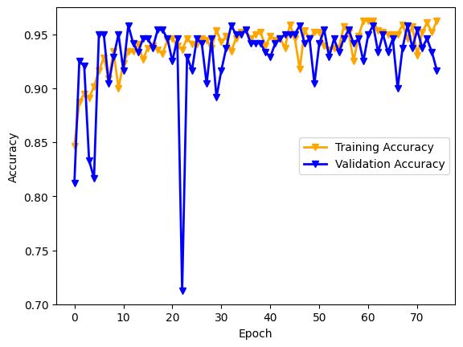
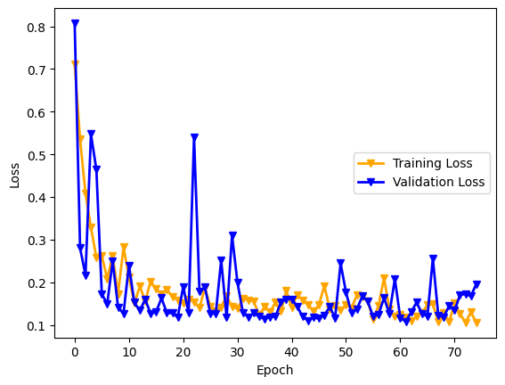
Fig.4. Accuracy
Fig 5. Loss

Slide 14
MODULE 3:Alzheimer’s Disease Stage Analysis & Report Generation
Module 3 – Overview
Clinical Decision Support – Risk Assessment & Alerts
Clinical Decision Support System (CDSS)
Objective: Assist clinicians in diagnosing Alzheimer’s disease using MRI-based risk analysis
MRI classification outputs are converted into clinical risk scores
Disease staging categories:
  Normal
  Mild Cognitive Impairment (MCI)
  Alzheimer’s Disease
Risk Thresholds
Normal: < 40%
MCI: 40–70%
Alzheimer’s: > 70%
Automated Clinical Alerts
High risk → Immediate neurologist consultation
Moderate risk → Cognitive assessment & follow-up MRI
Low risk → Routine monitoring

Slide 15
CLINICAL REPORTING & DECISION SUPPORT
Automated Patient Report Generation – System automatically creates structured MRI analysis reports.
Detailed Report Contents – Includes Patient ID, MRI details, disease stage, risk percentage, and suggested clinical action.
Decision Support Dashboard – Displays color-coded risk levels and confidence score for easy understanding.
Assistive Tool for Clinicians – Supports doctors in decision-making (human-in-the-loop system).
Clinical Benefits – Enables early detection, reduces diagnostic time, and improves accuracy.

Slide 16
Future Scope
Use of 3D MRI and multimodel imaging to improve early and accurate detection of Alzheimer’s Disease.
Development of advanced deep learning models such as 3D CNNs and transformer-based architectures for better classification.
Creation of a real-time clinical decision support system where doctors can upload MRI scans and obtain automated diagnosis.
Expansion using large, diverse datasets collected from multiple hospitals to improve model reliability and generalization.

Slide 17
Conclusion
The automation of diagnostic procedures is set to enhance the speed of diagnosing AD; a process typically conducted using MRI slices.
This study involved classification using SoftMax, utilizing traditional features.
The experimental findings of this work indicate that the accuracy achieved through DN169 categorization is 92.8%.

Slide 18
References
Acharya, U.R., Fernandes, S.L., WeiKoh, J.E., Ciaccio, E.J., Fabell, M.K.M., Tanik, U.J., Rajinikanth, V. and Yeong, C.H., 2020. Automated detection of Alzheimer’s disease using brain MRI images–a study with various feature extraction techniques. Journal of medical systems, 43(9), p.302.
Pallawi, S. and Singh, D.K., 2021. Review and analysis of deep neural network models for Alzheimer's disease classification using brain medical resonance imaging. Cognitive Computation and Systems, 5(1), pp.1-13.
Chen, L., Qiao, H. and Zhu, F., 2022. Alzheimer's Disease diagnosis with brain structural MRI using multiview-slice attention and 3D convolution neural network. Frontiers in Aging Neuroscience, 14, p.871706.
Al-Khasawneh, M.A., Alzahrani, A. and Alarood, A., 2023. Alzheimer’s Disease Diagnosis Using MRI Images. In Data Analysis for Neurodegenerative Disorders (pp. 195-212). Singapore: Springer Nature Singapore.
Heenaye-Mamode Khan, M., Reesaul, P., Auzine, M.M. and Taylor, A., 2024. Detection of Alzheimer’s disease using pre-trained deep learning models through transfer learning: a review. Artificial Intelligence Review, 57(10), p.275.
Pusparani, Y., Lin, C.Y., Jan, Y.K., Lin, F.Y., Liau, B.Y., Ardhianto, P., Farady, I., Alex, J.S.R., Aparajeeta, J., Chao, W.H. and Lung, C.W., 2023. Diagnosis of Alzheimer’s disease using convolutional neural network with select slices by landmark on Hippocampus in MRI images. IEEE Access, 11, pp.61688-61697.
Chui, K.T., Gupta, B.B., Alhalabi, W. and Alzahrani, F.S., 2022. An MRI scans-based Alzheimer’s disease detection via convolutional neural network and transfer learning. Diagnostics, 12(7), p.1531.
Al-Khasawneh, M.A., Alzahrani, A. and Alarood, A., 2023. Alzheimer’s Disease Diagnosis Using MRI Images. In Data Analysis for Neurodegenerative Disorders (pp. 195-212). Singapore: Springer Nature Singapore.
Şener, B., Açıcı, K. and Sümer, E., 2025. Improving early detection of Alzheimer’s disease through MRI slice selection and deep learning techniques. Scientific Reports, 15(1), p.2926
Inan, M.S.K., Sworna, N.S., Islam, A.M., Islam, S., Alom, Z., Azim, M.A., Shatabda,S. and Alzheimer’s Disease Neuroimaging Initiative, 2024. A slice selection guided.

Slide 19
    THANK YOU

